Slide 1
Drilling on the Green
My experiences in autumn 2012

Slide 2
Introduction
Clive Bailye
Managing Partner TWB Farms

Slide 3
Background
TWB Farms is an all combinable crops farm based near Lichfield, Staffordshire.
Rapidly expanding business for last 15 years.
Crops grown include winter wheat, winter rape, winter and spring beans, spring oats and spring linseed.

Slide 4
Old System
The farm has run a min-til system for the past 16 years
After steady evolution was running a 6m simba solo ‘R’ one pass cultivator and Vaderstad Rapid drill based around 609hp rubber tracked Challenger MT875c and 330 hp JD 8530 wheeled tractors.
This 2 pass min-till establishment system had made significant financial and time savings over more traditional plough based systems however a long held interest and a few past experiments with direct drilling has always made us feel there was a better way still.

Slide 5
Sledge hammer to crack a nut ?

Slide 6
Total power employed 2011
Challenger and JD 8530 tractors with a combined power output of 930hp
2 man establishment system
LOTS ! Of fuel and wearing metal

Slide 7
Why change ?
Sustainability
Need to improve our soils
Fuel Prices
Fixed cost savings
Simplification
Reduced labour requirement
Light land – lower moisture loss
Higher Yields ??? !!!! (hopefully)

Slide 8
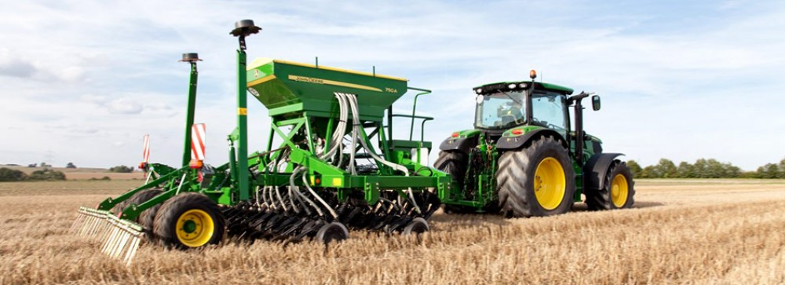
New System 2012
160hp tractor and a 4m used JD 750a drill !

Slide 9
Rotation
Winter Wheat
Winter OSR
Winter Wheat
Cover crop
Spring Oats, Spring Beans or Linseed

Slide 10
Good year to change ?
Wettest autumn for over 100 years
Massive slug pressure
Ground damaged at harvest
Committed so no Choice but to make it work !
At least failure would be a cheap failure !!
At least we were not damaging soil by trying !!

Slide 11
Patience !
Waiting for a weather window
First wheat drilling 15th October
Would still have been too wet for our old system
Most locally resort to plough p/harrow combo

Slide 12
Result ??
Despite these extremes we have managed so far to stick mostly to our plan, avoided soil damage and got crops in and growing
85% of planned WW area established
About 5% failed
100% planned OSR area established
About 3% failed

Slide 13
Drilling in 2012 first day out
Wheat after OSR
Nice easy start on a block of land after OSR that had no volunteers, we are applying 4kg of Detrex on the back of the drill as I could find a few slugs and eggs.
The soil – very light and free draining on this block of land
Number of worms was encourageing at least half a dozen uncovered in a spade full, I didn’t expect to see them increasing so soon so maybe the solo and rapid were doing more harm to them than I thought ??

Slide 14
First day out - Pictures

Slide 15
First day - Pictures
Notes:
Soil – light but wet

Slide 16
First day - Pictures
Notes:
Pic showing the pelleter on the drill – 4kgs / ha Detrex Pheric Phosphate

Slide 17
First day - Pictures
Notes:
After the drill – minimal disturbance and slot closed well

Slide 18
Wheat After Oats

Slide 19
WW After Oats – before Drill

Slide 20
WW After Oats – After Drill (minimal disturbance)

Slide 21
WW After Oats – Finished field

Slide 22
Termination Timing ?
To windy to spray BUT a window to drill !
Decided to spray after drilling
Interesting slug observations !
Pushed idea further so glyphosate 2 weeks after drilling

Slide 23
Slugs
4kg Ferric phosphate at drilling
Observed slugs staying on OSR plants
NO seed hollowing seen ! No use of Deter
Ready for attack at crop emergence
Slugs seem to stay on OSR volunteers
More pellets applied as OSR disappeared
1 x 4kg application or 2 on some blocks

Slide 24
Wet soil – less of a problem !

Slide 25
After Drilling

Slide 26
Green cover carried the Drill

Slide 27
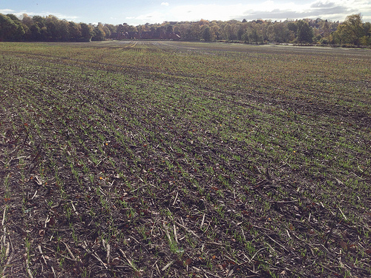
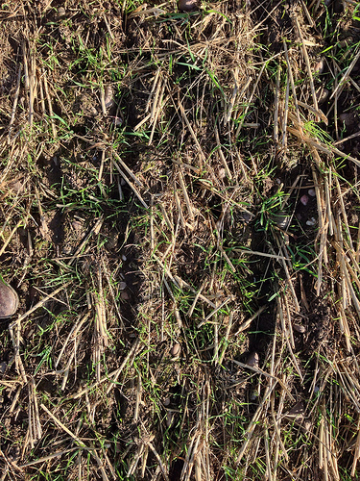
What happened next ?
That first drilling after OSR (November 22nd)

Slide 28
Looking down rows (Mid November)

Slide 29
And Last week

Slide 30
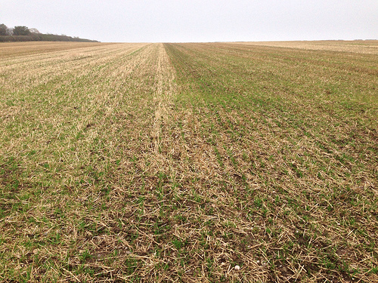
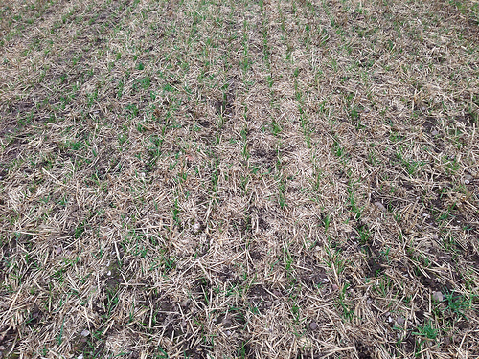
What happened next
That WW after Oats (22nd October)

Slide 31
And last week

Slide 32
WW into thick OSR cover (late termination)

Slide 33
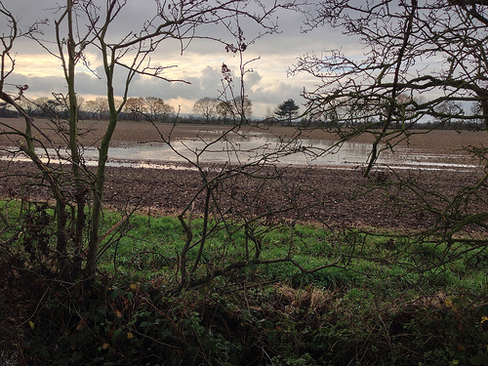
Looking over the fence (same day)
Established same day – p/harrow combi

Slide 34
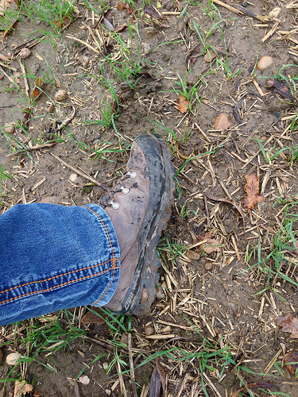
Morning after 60mm of rain
Notes:
Ground takes water and travels so much better undisturbed

Slide 35
And last Week

Slide 37
Future Plans
Add a second drill – tine based to the system for capacity and flexibilty
Use RKT to control harvest traffic on 10m harvest /30m sprayer system. Fixed tramlines
Closer focus on Soils to balance nutrition
Extensive use of compost to help OM content
No straw sales again !
Use cover crops whenever posible

Slide 38
My Blog
www.750a.co.uk

Slide 39
OSR

