Slide 1
Nicolas Duboust

Slide 3
La ferme du hamel : 200 ha works with a neighbourg with 200 ha
Lonrai

Slide 4
Stopped plowing in 1998

Slide 5
Intensif no_till

Slide 6
2002

Slide 7
Two plow pan : plow no_till

Slide 8
Small rotation : slugs weeds low yields

Slide 9
What should i do ? Plowing once again direct drilling ?

Slide 10
Let’s go and see what’s happening outside of my farm

Slide 12
talking with users

Slide 13
2008 Sold the vady buy a jurri

Slide 19
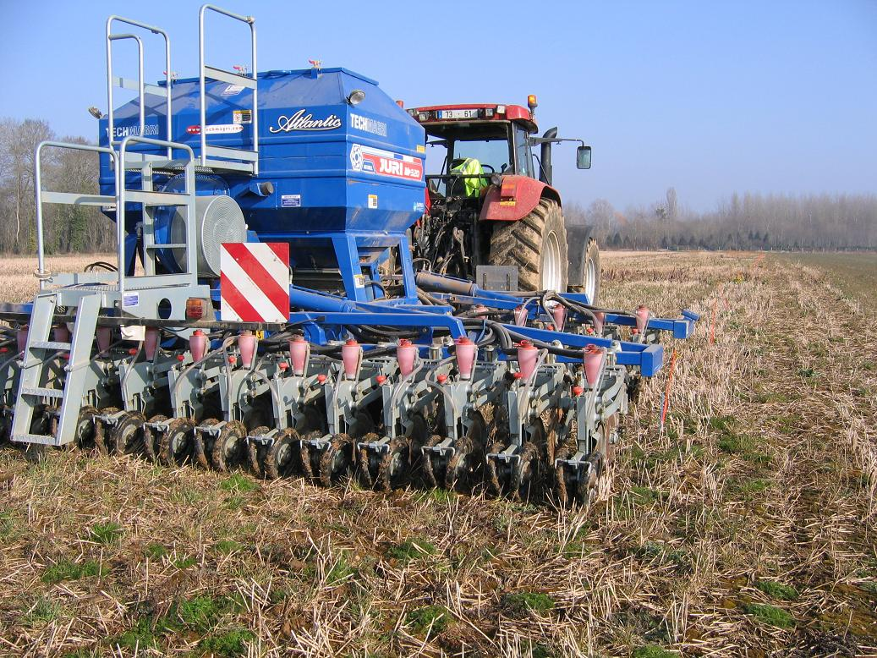

Slide 23
Signs of life

Slide 24
Yields not at the rendez vous

Slide 34
2009

Slide 49
2011

Slide 64
My goals :

Slide 69
Never forget we are borrowing their earth

Slide 73
The group will always be stronger than the strongest individual in the group

