Slide 1
Are Mob-Grazed Cattle the Perfect Arable Break?
Tom Chapman
tom@heathchapman.com
+44 (0)7717 505287

Slide 2
BASE UK British Association of Sexual Educators

Slide 3
Oxford Street, London

Slide 4
The Sun!

Slide 5
Photosynthesis Equation
Carbon Dioxide
+
Water
Glucose
+
Oxygen
(Sunlight Energy)
Sun’s energy is captured and locked into the glucose molecule

Slide 6
Glucose Molecule – C6H12O6

Slide 7
The Sun

Slide 8
The Earth!

Slide 9
My Goals:
Capture and sell sunlight

Slide 10
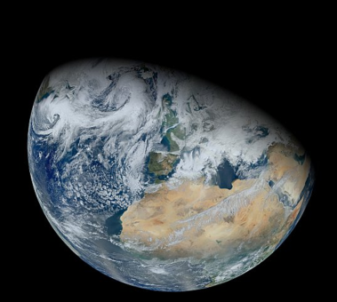
My Goals:
Capture and sell sunlight
Build new soil

Slide 11
My Goals:
Capture and sell sunlight
Build new soil
Spend no money doing it!

Slide 12
“From the top of Pawnee Rock I could see six to ten miles in almost every direction. The whole vast space was covered with buffalo looking, at a distance, like one compact mass, the visual angle not permitting the ground to be seen”
From “The extermination of the American Bison” by William T Hornaday

Slide 13
Set Stocking – no recovery period

Slide 14
24-day Rotation – 18 days’ recovery

Slide 15
Mob Grazing – 54 days’ recovery

Slide 16
Grazing Exposure – 200 day season
Grazing regime | Number of days grazing exposure during the season
Set stocked | 200 days grazing exposure
New Zealand-type 24-day rotation | 50 days grazing exposure
Mob-grazing 55-day rotation | < 4 days grazing exposure

Slide 17
Mob Grazing - Saskatchewan

Slide 18
Hay-meadow effect - Missouri

Slide 19
Roots match Shoots

Slide 20
Trampled Forage - Nebraska

Slide 21
Peat-like Layer - Saskatchewan

Slide 22
Peat-like Layer - Saskatchewan

Slide 23
My Goals:
Capture and sell sunlight
Build new soil
Spend no money doing it!

Slide 24
Fernando Pacin – S. Buenos Aires

Slide 25
Mixed -v- Arable Only

Slide 26
Capturing the sun

Slide 27
Capturing the sun

Slide 28
Capturing the sun

Slide 29
Plant Groups
Cool Season Grasses Barley Rye Wheat Triticale Cocksfoot | Cool Season Broadleaves Lentil Pea Forage Radish Sweet clover Sugar beet
Warm Season Grasses Maize Sorgum Sudangrass | Warm Season Broadleaves Buckwheat Hairy Vetch Sunflower Cowpea

Slide 30
Soil Crop Health Timeline

Slide 31
Encouraging New Entrants
Access to Land
New Entrant Farmer

Slide 32
Encouraging New Entrants
Access to Land
Capital investment
New Entrant Farmer

Slide 33
Oxford Street, London

Slide 34
Grazing cattle across East Anglia

Slide 35
The Golden Rules
Always keep soil covered

Slide 36
The Golden Rules
Always keep soil covered
Try to keep a growing crop in the ground at all times

Slide 37
The Golden Rules
Always keep soil covered
Try to keep a growing crop in the ground at all times
Grow a mixture of plant types through the year

Slide 38
The Golden Rules
Always keep soil covered
Try to keep a growing crop in the ground at all times
Grow a mixture of plant types through the year
Do not cultivate or disturb the soil

Slide 39
The Golden Rules
Always keep soil covered
Try to keep a growing crop in the ground at all times
Grow a mixture of plant types through the year
Do not cultivate or disturb the soil
Include grazing livestock in your rotations

Slide 40
Thank You
“Feed the soil and the soil will feed you”
Tom Chapman
tom@heathchapman.com
+44 (0)7717 505287

